Slide 1
Exam-I Review NFS 100

Slide 2
Practice Question 1
All essential nutrients are divided into _________ groups.
Six
Four
Three
Five
Answer: A

Slide 3
Practice Question 4
All vitamins and minerals in a food have to be listed on the Nutrition Facts label?
True
False
Answer: B

Slide 4
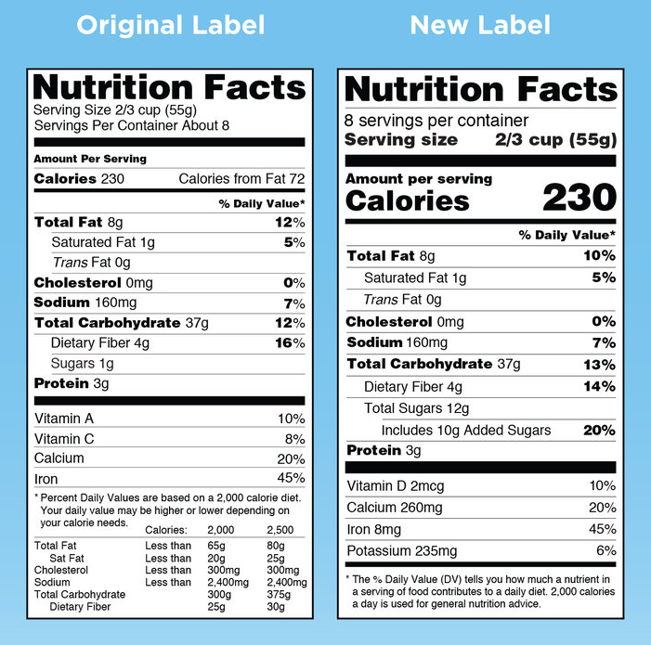
Original and New Nutrition Facts Panel

Slide 5
Practice Question 2
The Dietary Guidelines for Americans recommends consuming less than _________ mg of sodium per day.
1,000 mg
1,500 mg
2,300 mg
3,000 mg
Answer: C

Slide 6
Practice Question 3
If a food contained 15 g of fat and had no protein or carbohydrate, how much energy would it contain?
145 kcal
135 kcal
155 kcal
150 kcal

Slide 7
How do you know a product is rich or poor in a particular nutrient?
< 5% DV- is poor source
> 20% DV- is rich source
Notes:
A product is rich in a particular nutrient if it provides > 20% DV
A product is poor in a particular nutrient if it provides < 5% DV

Slide 8
What is the difference between dietary reference intakes; EAR and RDA ?

Slide 9
Dietary Guidelines for Americans include advice on each of the following EXCEPT:
sodium and fat
alcohol and sugars
food safety
food costs

